Slide 1
React Router and Single Page Application (SPA)

Slide 2
Objectives
What is Single Page Application?
How SPAs Work
Advantages/Disadvantages of SPAs
Create Single Page Application with React Router.

Slide 3
Definition of a Single Page Application
What is an SPA?
A Single Page Application (SPA) is a web application that loads a single HTML page and dynamically updates its content as the user interacts, without full page reloads.
Built using JavaScript frameworks like ReactJS, Angular, or Vue.js.
Core Concept:
The browser loads a JavaScript bundle that handles rendering and navigation client-side.
Data is fetched from servers (e.g., via APIs) to update the UI dynamically.
Key Difference from Traditional Websites:
Traditional: Each page request reloads the entire page from the server.
SPA: Only data is fetched, and the UI is updated in the browser.

Slide 4
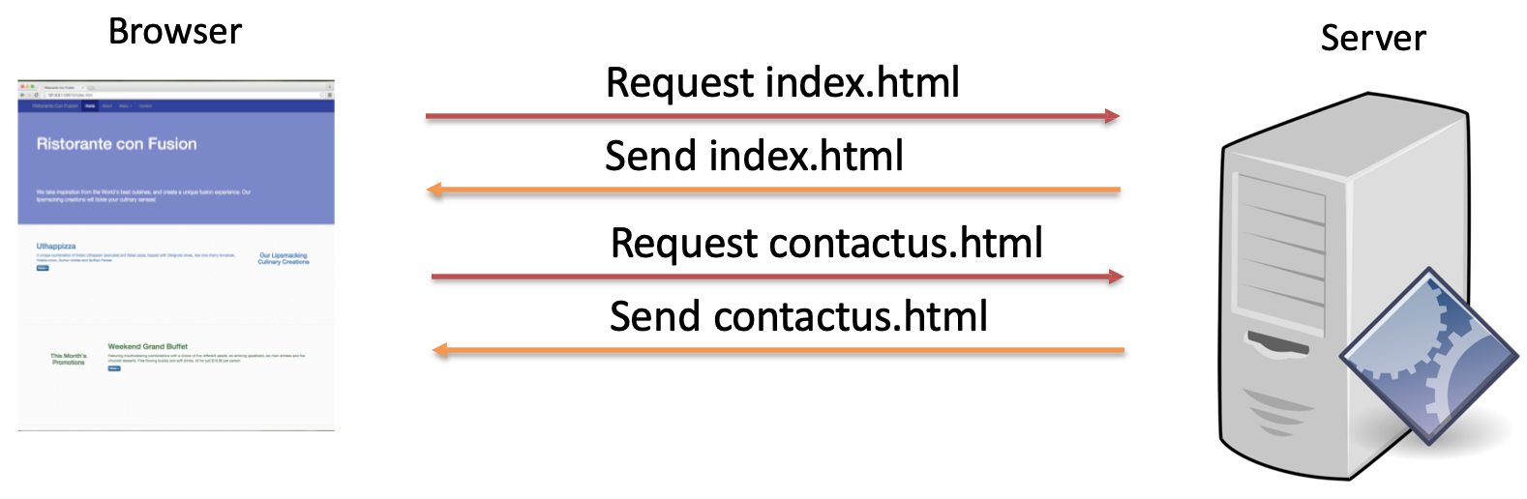
Traditional WebSites

Slide 5
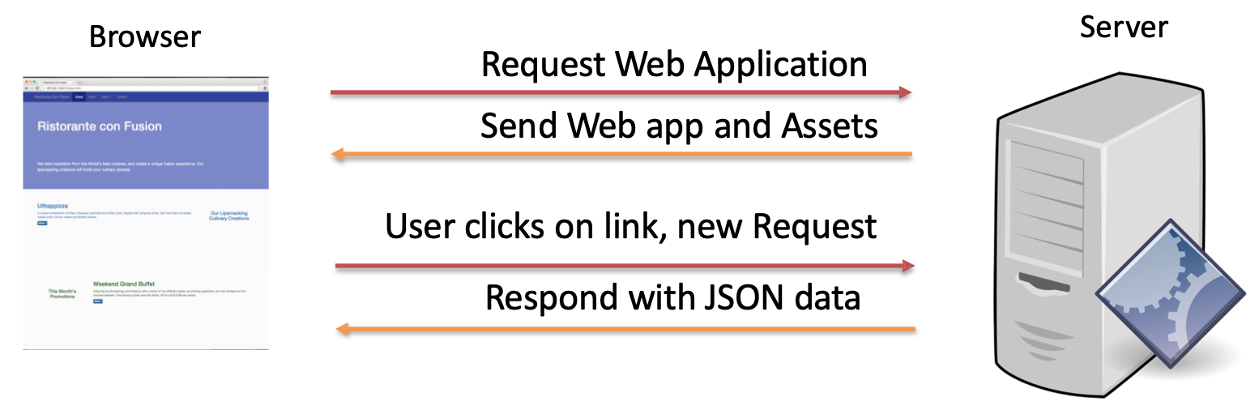
Single Page Applications

Slide 6
How SPAs Work
Architecture:
SPAs rely on Client-Side Rendering (CSR) within a client-server model.
Client: ReactJS app running in the browser, managing UI and state.
Server: Provides data via APIs (REST, GraphQL).
Process:
Browser loads a minimal HTML file with a JavaScript bundle.
ReactJS renders the initial UI and listens for user interactions.
Navigation or actions trigger API calls to fetch/update data.
UI updates dynamically without reloading the page.
Tools:
React Router: For client-side navigation.
Axios/Fetch: For API communication.

Slide 7
Examples of Single Page Applications
Real-World Examples:
Gmail: Email interface updates dynamically without page reloads.
Trello: Boards and cards are managed client-side with API calls.
Spotify Web Player: Music playback and navigation in a single page.
ReactJS SPA Example: A to-do list app
Loads once, renders a list of tasks.
User adds/deletes tasks, triggering API calls (e.g., POST /api/tasks).
UI updates instantly using React state and components.
import { useState, useEffect } from 'react';
import axios from 'axios';
function TodoList() {
const [todos, setTodos] = useState([]);
useEffect(() => {
axios.get('/api/todos').then(res => setTodos(res.data));
}, []);
return <ul>{todos.map(todo =>
<li key={todo.id}>{todo.text}</li>)}</ul>;
}

Slide 8
Advantages of SPAs
Fast User Experience:
After initial load, navigation is instantaneous since only data is fetched.
Example: Clicking a menu in a ReactJS app updates the view without reloading.
Rich Interactivity:
Supports complex, desktop-like interfaces (e.g., drag-and-drop, real-time updates).
Ideal for apps like project management tools or social media platforms.
Reduced Server Load: Servers handle data requests (APIs) rather than rendering HTML.
Developer Productivity: Frameworks like ReactJS simplify UI development with reusable components.
Offline Capabilities: SPAs can cache data (e.g., using Service Workers) for partial offline use.

Slide 9
Disadvantages of SPAs
Initial Load Time:
Large JavaScript bundles can slow down the first page load.
Mitigation: Code splitting, lazy loading in ReactJS.
SEO Challenges:
Search engines may struggle to index dynamic content.
Mitigation: Prerendering, Server-Side Rendering (SSR), or Static Site Generation (SSG).
Memory Usage: SPAs keep state and DOM in memory, which can strain low-end devices.
JavaScript Dependency:
Requires JavaScript to be enabled in the browser.
Mitigation: Progressive enhancement or fallback content.

Slide 10
SPAs in the Client-Server Context
Client-Server Integration:
SPAs are client-heavy, relying on APIs for data.
Communication: HTTP/HTTPS (REST, GraphQL) or WebSockets for real-time.
Message Format: Primarily JSON.

Slide 11
When to Use SPAs?
Best Use Cases:
Interactive applications (e.g., dashboards, CRMs, email clients).
Apps requiring real-time updates (e.g., chat, collaborative tools).
Internal tools where SEO is not critical.
Not Ideal For:
Content-heavy sites needing strong SEO (e.g., blogs, news sites).
Apps targeting low-power devices with limited JavaScript capabilities.
Alternatives:
SSR (Next.js): For SEO and faster initial loads.
SSG (Gatsby): For static content with some dynamic features.

Slide 12
Demo of SPA with React Router DOM
Build a ReactJS SPA with two "pages": ListOfOrchids, OrchidDetails
Use React Router DOM for navigation and Axios for API calls.

Slide 13
Setup
Create a Vite project:
npm create vite@latest spa-demo -- --template react
cd spa-demo
npm install
Install dependencies:
npm install react-router axios react-bootstrap bootstrap
MockAPI Setup:
Sign up at mockapi.io.
Create a project and define a resource.
Project Structure:
spa-demo/
├── src/
│ ├── components/
│ │ ├── ListOfOrchids.jsx
│ │ ├── OrchidDetails.jsx
│ ├── App.jsx
│ ├── main.jsx
│ ├── index.css
├── vite.config.js
├── package.json
├── .env

Slide 14
Setting Up MockAPI
Create a MockAPI Project:
Go to mockapi.io and log in.
Create a new project (e.g., orchids).
Define a Resource:
Resource: orchids
Fields: id (auto-generated), orchidName (string), isNatural (Boolean), description (String), isNatural (Boolean), image (String) .
Example endpoint: https://<your-mockapi-id>.mockapi.io/orchids
Endpoint: Stored in .env as VITE_API_URL
Test the API: Use a browser or Postman to verify GET/POST requests.

Slide 15
Configuring .env File
Create .env in Project Root:
VITE_API_URL=https://<your-mockapi-id>.mockapi.io/orchids
Notes:
Use VITE_ prefix for environment variables in Vite.
Access variables with import.meta.env.VITE_API_URL.
Add .env to .gitignore to avoid exposing sensitive data.
Restart Server: After adding .env, restart with npm run dev.

Slide 16
Setting Up Routes (App.jsx)
import 'bootstrap/dist/css/bootstrap.min.css';
import { Routes, Route } from 'react-router'
import ListOfOrchids from './components/ListOfOrchids';
import DetailOrchid from './components/DetailOrchid';
import NavBar from './components/NavBar’;
function App() {
return (
<>
<NavBar/>
<Routes>
<Route path=‘/’ element={<ListOfOrchids/>}/>
<Route path=detail/:id' element={<DetailOrchid/>}/>
</Routes>
</>
)
}
export default App

Slide 17
ListOfOrchids Components - Demo
import React, { useEffect, useState } from 'react'
import Table from 'react-bootstrap/Table';
import Container from 'react-bootstrap/esm/Container';
import {Image } from 'react-bootstrap'
import axios from 'axios';
import { Link } from 'react-router'
export default function ListOfOrchids() {
const baseUrl = import.meta.env.VITE_API_URL
const[orchids, setOrchids] = useState([])
useEffect(() => {
fetchData();
}, [])
const fetchData = async () => {
try {
const response = await axios.get(baseUrl);
const sortedData = response.data.sort((a, b) =>
parseInt(b.id) - parseInt(a.id));
setAPI(sortedData);
} catch (error) {
console.error('Error fetching data:', error);
}
};
return (
<Container>
....
</Container>
)
}
<Table striped bordered hover my-5>
<thead>
<tr>
<th>Image</th>
<th>Orchid name</th>
<th>Original</th>
</tr>
</thead>
<tbody>
{orchids.map((orchid)=>(
<tr key={orchid.id}>
<td><Image src={orchid.image} width={40} rounded />
</td>
<td>
<Link to={`edit/${orchid.id}`}>
{orchid.orchidName}
</Link>
</td>
<td>{orchid.isNatural ?
<span class="badge text-bg-success">Natural</span>
: <span class="badge text-bg-warning">Industry</span>}</td>
</tr>
))}
</tbody>
</Table>

Slide 18
OrchidDetails Components - Demo
import React from 'react';
import { useParams } from 'react-router';
import { Breadcrumb, Card, Badge, Image } from 'react-bootstrap';
import axios from 'axios';
export default function Detail() {
const [orchid, setOrchid] = React.useState({});
const params = useParams();
const id = params.id;
const baseUrl = import.meta.env.VITE_API_URL
React.useEffect(() => {
fetchData();
}, [id]); const fetchData = () => {
axios.get(`${baseUrl}/${id}`)
.then(response => {
setOrchid(response.data);
})
.catch(error => {
console.error('Error fetching data:', error);
});
}; return (
<div className="container py-5">
<div className="row">
………
</div>
</div>
);
}
<div className="col-12 col-md-8 p-3">
<Badge className="custom-chip my-3">
{orchid.orchidName}
</Badge>
<Card className="mt-3">
<Card.Header>
<p className="text-primary fs-5">{orchid.description}</p>
</Card.Header>
<Card.Body>
{orchid.isNatural ? (
<Badge className="custom-natural-chip">
This Orchid is a natural product
</Badge>
) : (
<Badge bg="warning" text="dark">
This Orchid is an industrial product
</Badge>
)}
</Card.Body>
</Card>
</div>
<div className="col-12 col-md-4 p-3">
<div className="badge-container">
<Image
src={orchid.image}
alt={orchid.orchidName}
/>
</div>
</div>

Slide 19
Running the Demo
Start the dev server: npm run dev
Open http://localhost:5173 in the browser.
Verify .env:
Ensure import.meta.env.VITE_API_URL is used in API calls.
Check console for errors if .env is misconfigured.
Test Features:
Show list of orchids.
Detail of orchid.

Slide 20
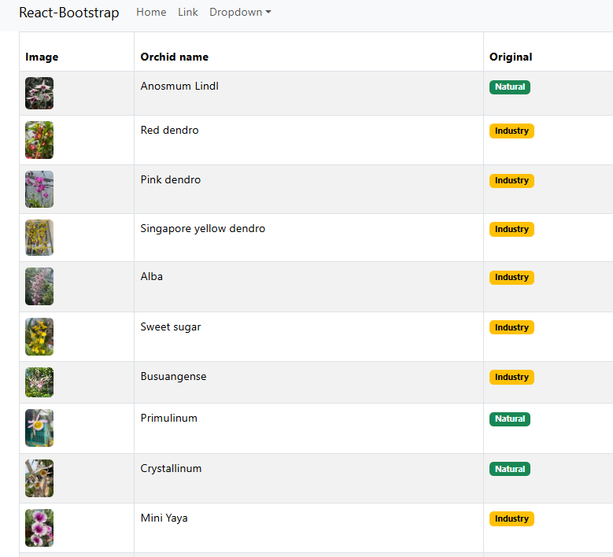
Result of List of orchids - Demo

Slide 21
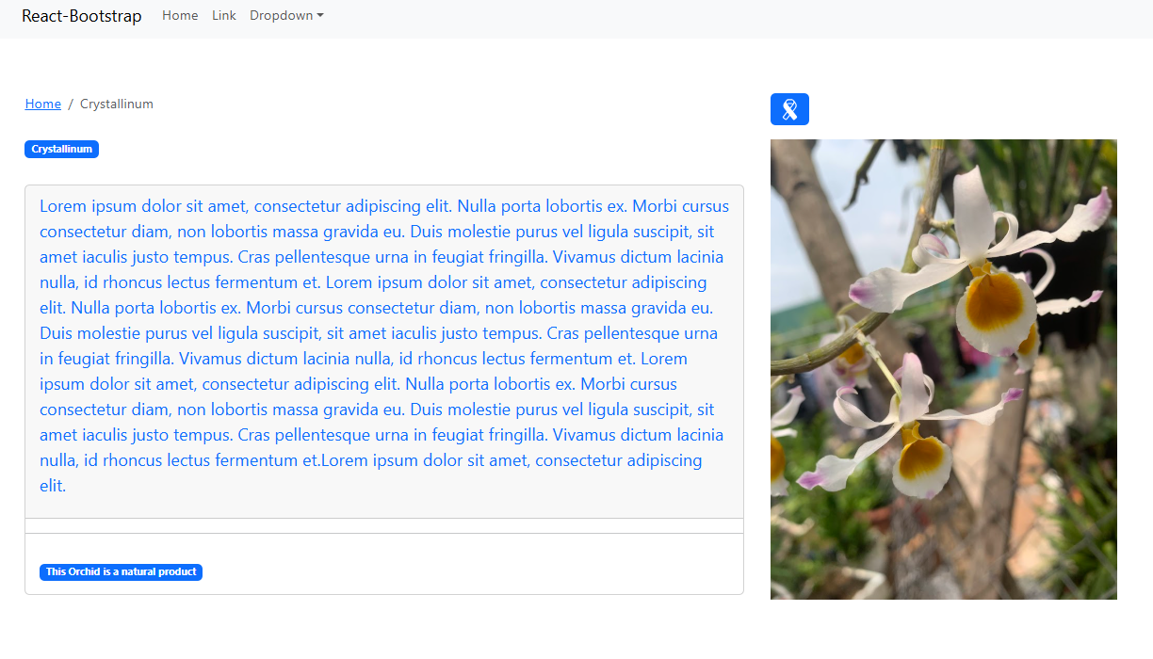
Result of detail of orchid - Demo

Slide 22
Summary
Concepts were introduced:
What is Single Page Application?
How SPAs Work
Advantages/Disadvantages of SPAs
Create Single Page Application with React Router.

